Slide 1

Retail Analysis with Walmart Data
Canisha Barron

Slide 2
Section 1
Walmart is one of the biggest companies in the US with many stores across the country. One very vital aspect of Walmart’s success is strategic planning and data analysis. The company has recently run into a Machine Learning algorithm error that has caused challenges due to unforeseen demands. As such, Walmart wants to acquire a model that would accurately predict future sales of the company.
Walmart considers that there will be factors impacting sales such as holidays or non-holidays, CPI, unemployment index, fuels price and temperature. The main holidays that affect weekly sales are Superbowl, Labour Day, Thanksgiving and Christmas. The company has collected data from 45 stores within the years of 2010-2012.
The goal of this analysis is to explore how weekly sales have been affected and to build a prediction model to forecast demand.
Business Scenario

Slide 3
Section 2
Which store has maximum sales
Which store has maximum standard deviation i.e., the sales vary a lot. Also, find out the coefficient of mean to standard deviation
Which store/s has good quarterly growth rate in Q3’2012
Some holidays have a negative impact on sales. Find out holidays which have higher sales than the mean sales in non-holiday season for all stores together
Provide a monthly and semester view of sales in units and give insights
Build a prediction model to forecast demands
Objectives

Slide 4
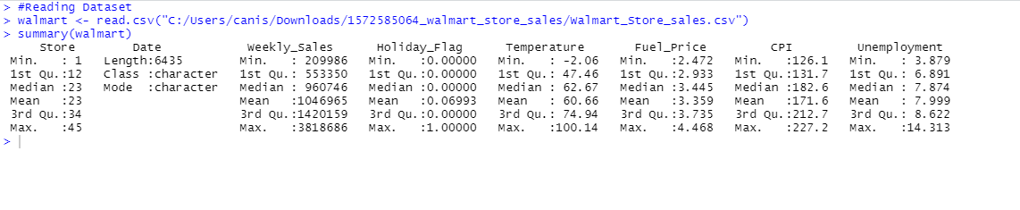
Section 3
Data Summary
The Walmart dataset summarizes each variable with interquartile ranges. The data shows that there are 45 stores and the average sales for this data is 1046965. The median of 0.0000 for Holiday Flag suggests that most weeks of the year are not holidays . Fuel price has a mean of 3.359, CPI has a mean of 182.6 and unemployment has a mean of 7.874. The Date variable is a character vector with length 6435. There are no missing observations from any variables provided.
In the dataset, it is important to note that all dates analyzed are Fridays and in 2012 there is no data in this dataset for November and December of 2012. The data was still thoroughly analyzed and generated insightful information.

Slide 5
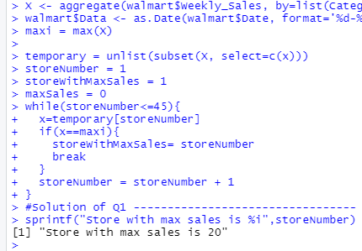
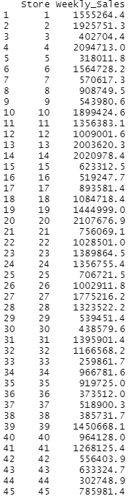
Section 4 Objective I
The aggregate function and while loop were used to determine which store has maximum sales and ggplot function was used to visualize this data via bar chart. The screen print zooms in to show store with the overall highest average sales and suggests that store 20 has the maximum sales.
Data Exploration

Slide 6
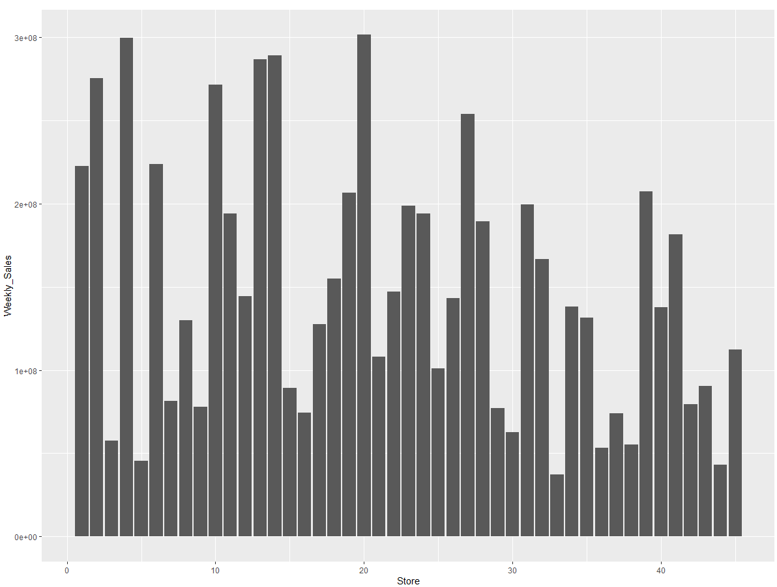
Section 4 Objective I
The bar chart shows the maximum sales of each store. It shows that store 20 has maximum sales.
Data Exploration

Slide 7
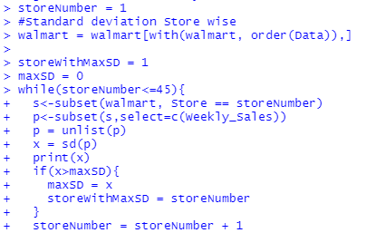

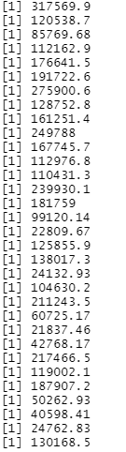
Section 4 Objective II
The while loop was used to find the store with maximum standard deviation. We can conclude that store 14 has the highest standard deviation. This signifies that the sales in store 14 vary a lot. The coV is the ratio of standard deviation to mean and is calculated by sd/mean * 100. The coV for store 14 is 0.15713677 or 15.713677%.
Data Exploration

Slide 8

Section 4 Objective III
All sales by store were added for Q3 ‘2012 and for Q3’ 2011 to compare the growth rate within Q3.
Sum sales were also compared for Q2 2012 & Q3 2012 to compare the growth rate from Q2 to Q3.
Data Manipulation
This Photo by Unknown Author is licensed under CC BY-SA

Slide 9
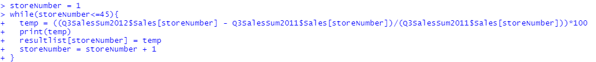
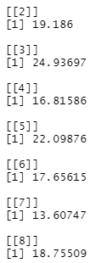
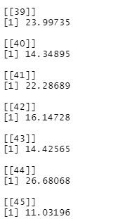
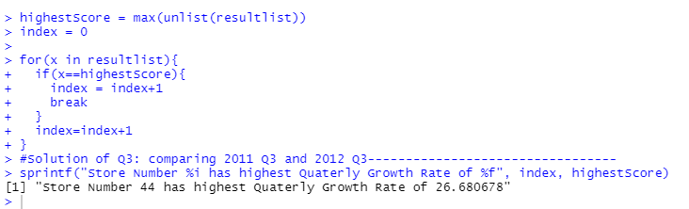
Section 4 Objective III
Data Manipulation
When analyzing 2011 to 2012 growth rate within Q3, Store 44 has highest quarterly growth rate of 26.680678 in Q3’2012 and store 3 also has good quarterly growth rate of 24.93697 in Q3’2012.

Slide 10
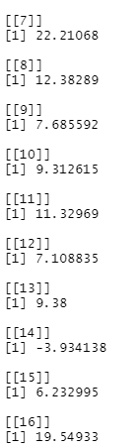
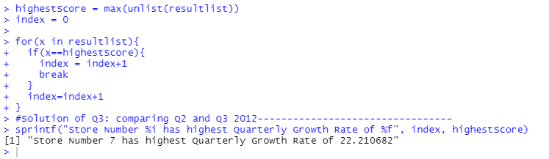
Section 4 Objective III
Data Manipulation
When analyzing Q2’2012 to Q3’2012 quarterly growth rate, store 7 has the highest quarterly growth rate of 22.210682. Store 16 also has good quarterly growth rate of 19.54933.

Slide 11

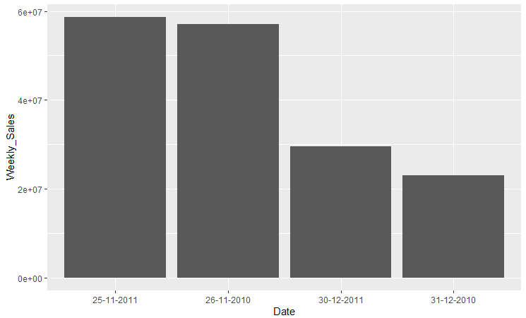
Section 4 Objective IV
Data Manipulation
This plot indicates that thanksgiving is the holiday with highest sales specifically on November 26th, 2012 and November 25th , 2011.

Slide 12
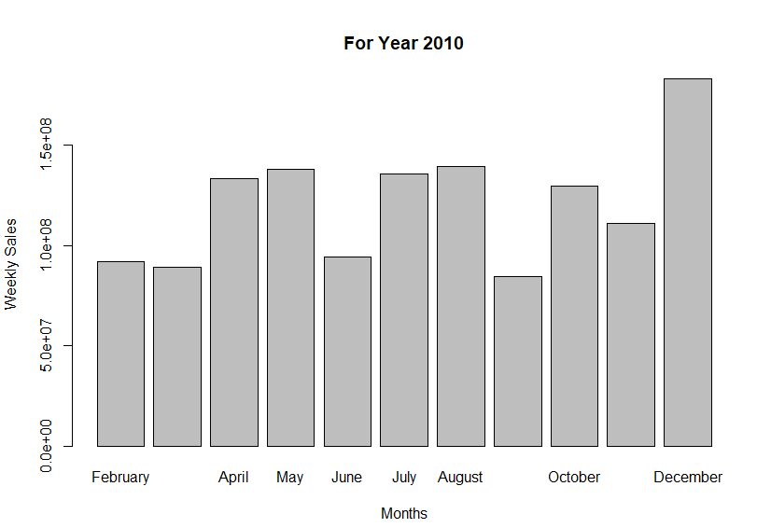
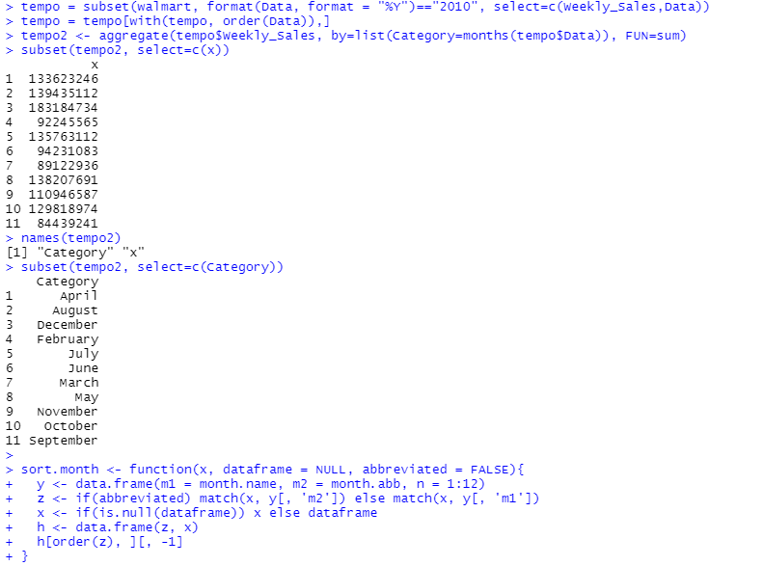
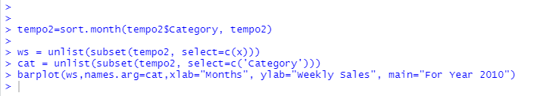
Section 4 Objective V
December is leading in weekly sales for the year 2010.
Data Manipulation

Slide 13
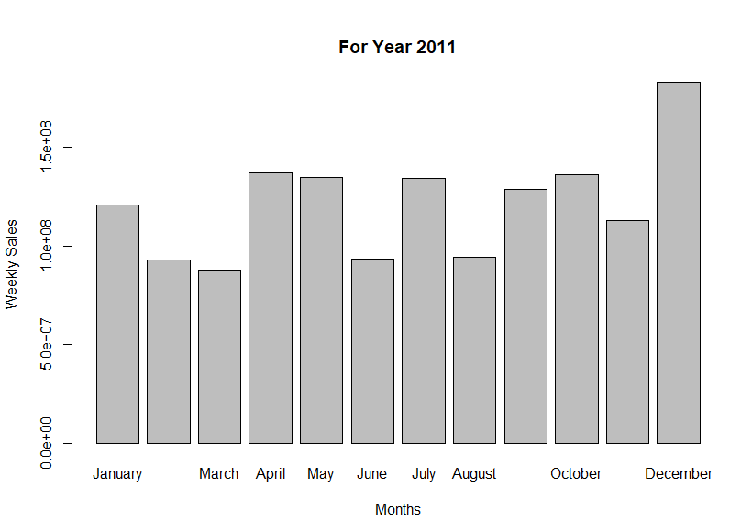
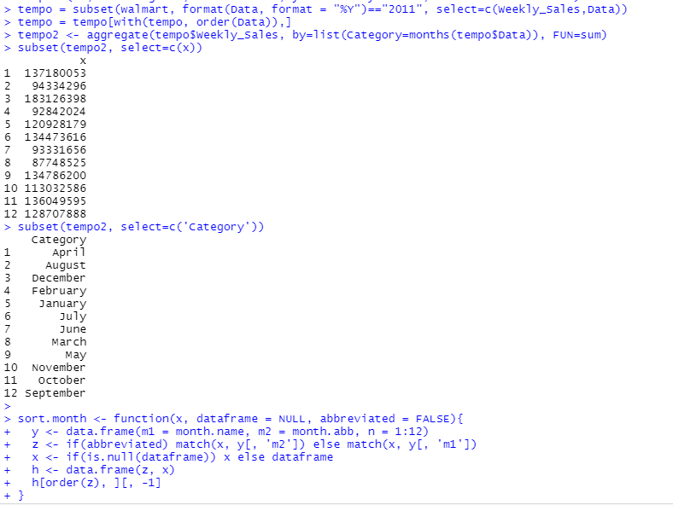

Section 4 Objective V
December is leading in weekly sales for the year 2011.
Data Manipulation

Slide 14
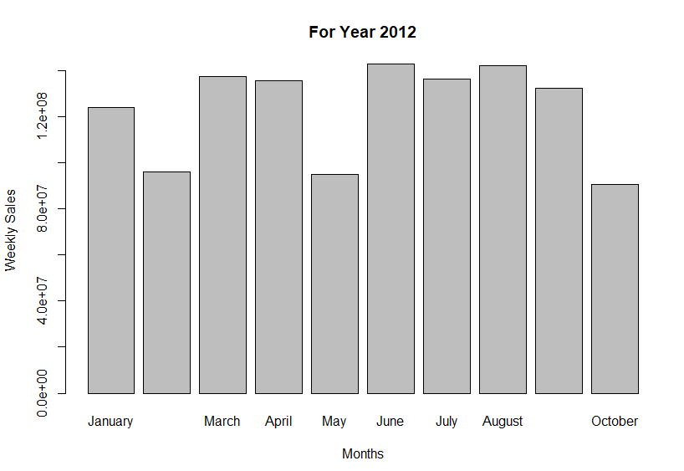
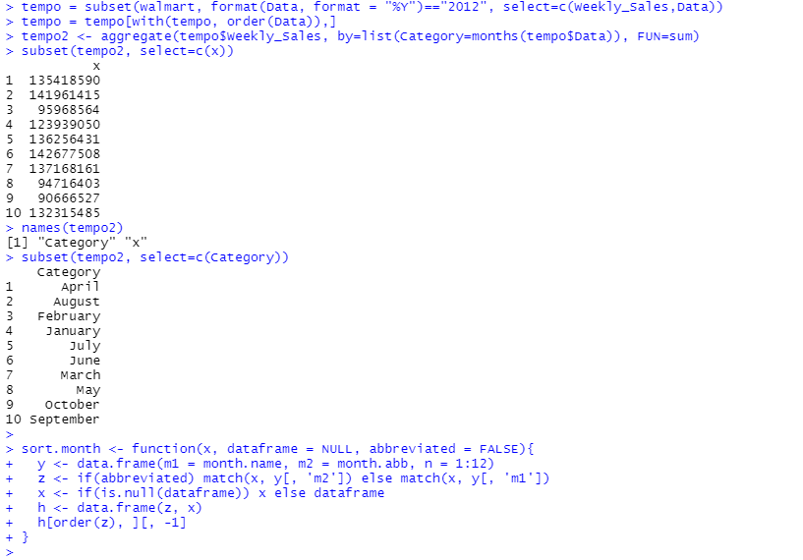
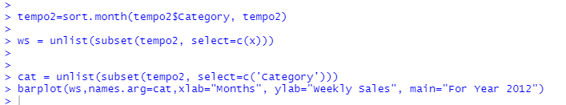
Section 4 Objective V
June is leading in weekly sales for the year 2012. Note that November and December are excluded from this dataset.
Data Manipulation

Slide 15
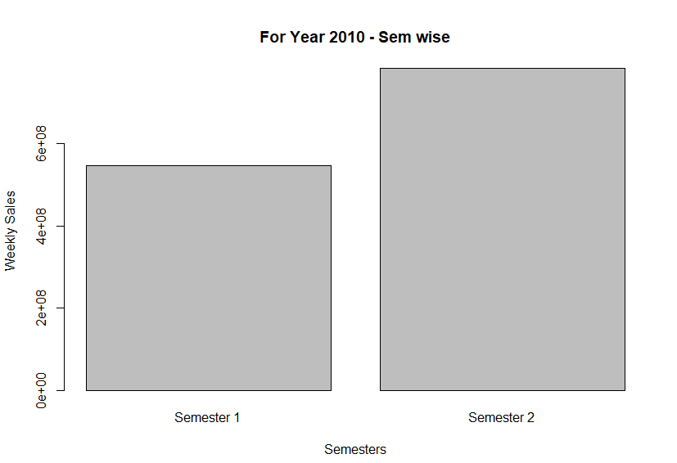
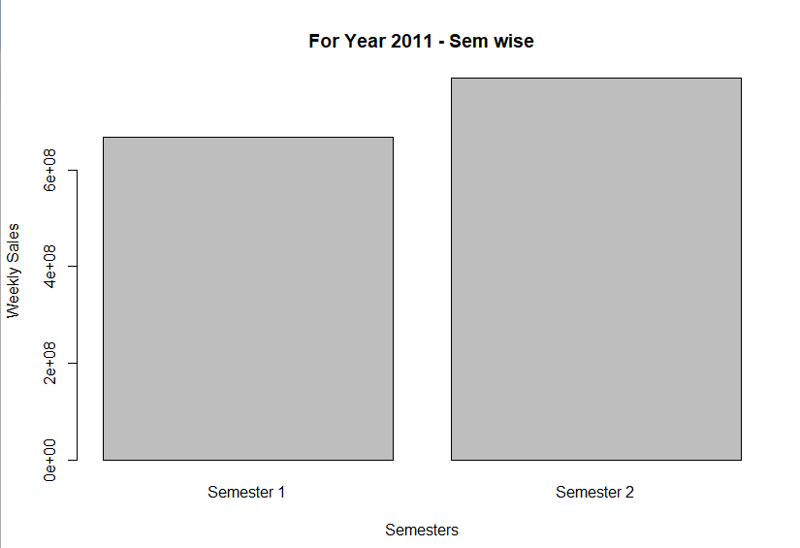
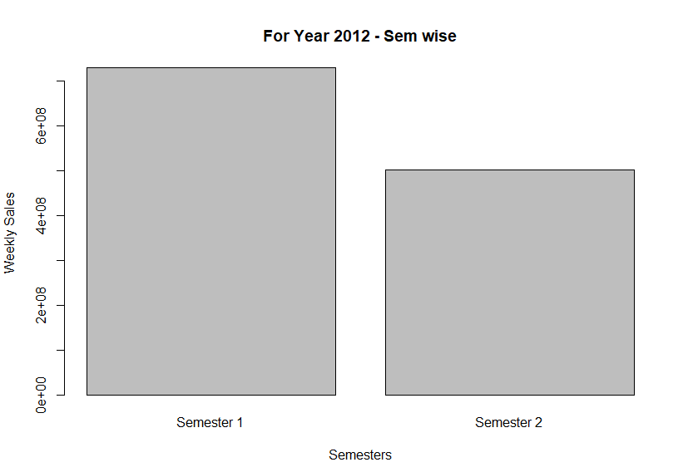

The bar charts below show a comparison of sales for the semester of 2010,2011 and 2012. Semester 2 has higher sales than semester 1 for the year 2010 and 2011. This is expected because December produced highest sales in these years. Semester 1 is higher than semester 2 in year 2012. Consider that November and December are excluded from 2012 dataset thus, the combination of high sales produced in semester 1 has outperformed semester 2.
Data Manipulation

Slide 16
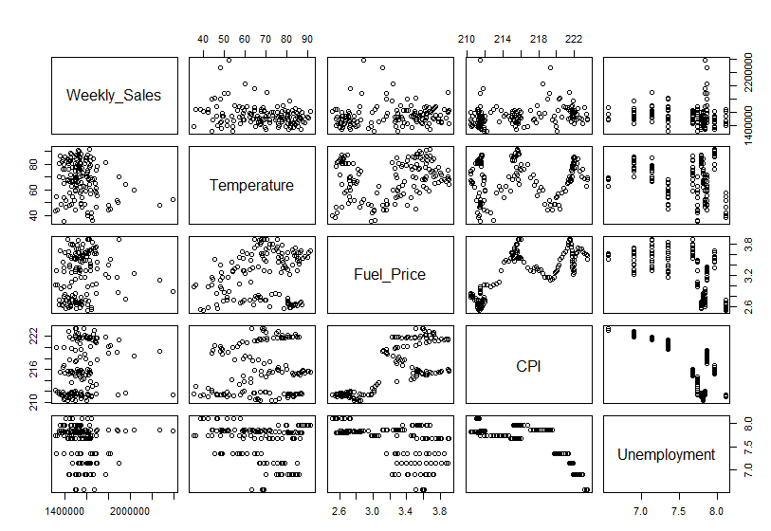
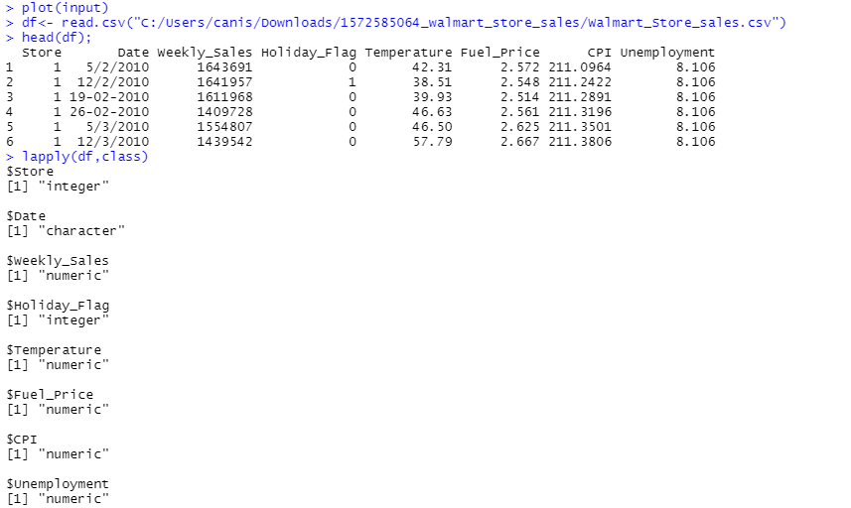
Section 5 Multiple Linear Regression
The plot shows that there is some correlation between the independent variables and the dependent variables. Weekly sales are somehow being affected by temperature, fuel price, CPI, unemployment

Slide 17
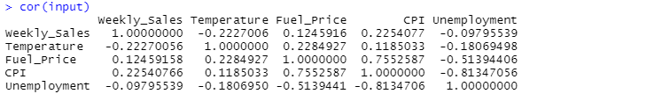
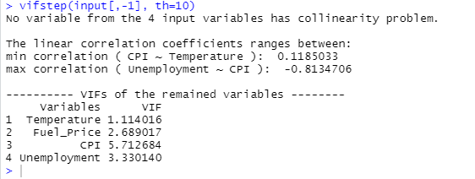
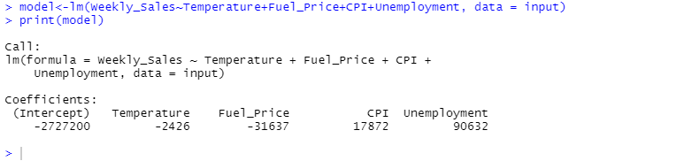
Statistical Analysis: The problem statement can be addressed using linear regression VIF Method
The Variance inflation factor (vif) was used to check for multicollinearity among the independent variables with a threshold of 10. All variables ranged below the threshold which means that they are not significantly affecting each other. Thus, model will be built with all variables.
The coefficients of each independent variable satisfies the linear model.
Weekly sales = 2727200 - 2426temp -31637fuel + 17872cpi + 90632umep

Slide 18
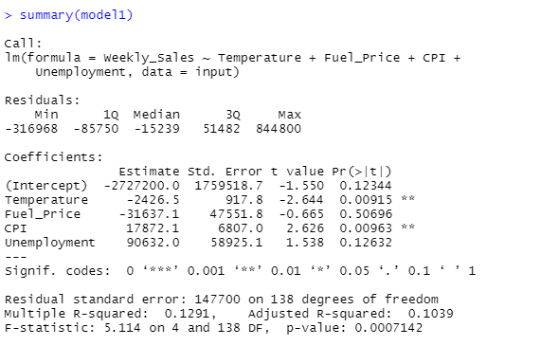
Statistical Analysis: Significance Method: Model 1
P values for all variables are below 0.05 except Fuel Price and Unemployment at 95% confidence level
We will remove Fuel Price and Unemployment as they are insignificantly affecting weekly sales.
Impact on weekly sales will be analyzed with only temperature and CPI.
Notice that in this regression Multiple R2(0.1291) and p-value (0.0007142) in this model.
Note the difference in R-sq and Adj R-sq is 0.0252
Weekly sales = 2727200 - 2426temp -31637fuel + 17872cpi + 90632umep

Slide 19
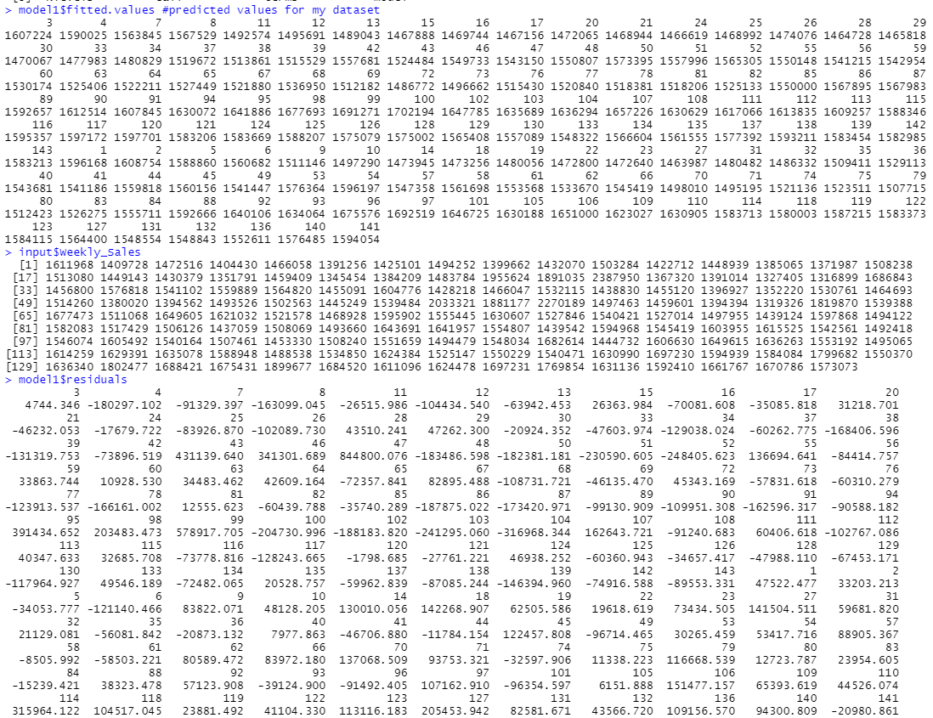
The predicted values and actual values can be compared with some level of error.
This execution shows the errors associated with this model.

Slide 20
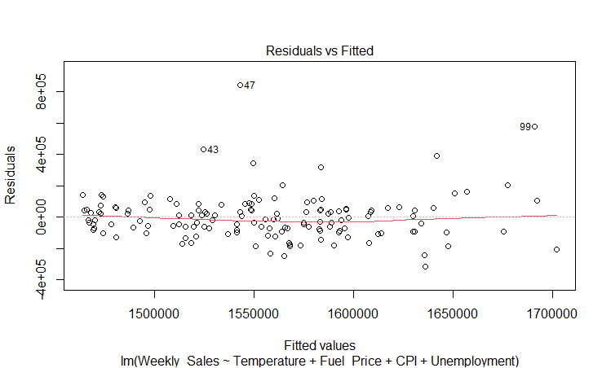
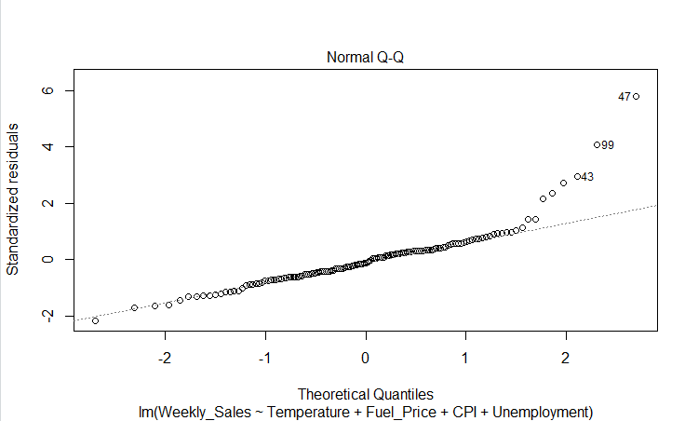
Data is homogeneously distributed indicating homoskedasticity. Relative to rest of the data points labeled 43, 47 & 99 are a little bit distant from the data.
There are a few outliers (43, 47 & 99) in the Normal Q-Q plot, but majority of the data falls on the line. We can say that the data is normally distributed.

Slide 21
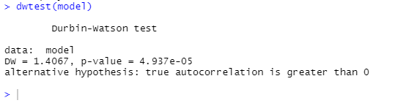
Dwtest is used to check for autocorrelation among residual errors.
Null hypothesis statement for correlation amongst residual errors.
H0:there is no correlation amongst residuals.
Null hypothesis cannot be rejected in this case. The errors in this data has autocorrelation as the p value is less than 0.05.

Slide 22
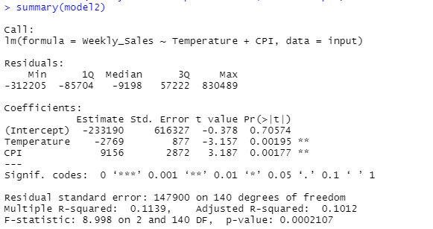
Statistical Analysis: Significance Method: Model 2
P values for all variables are below 0.05 which means that they both have strong influence on dependent variable..
Notice that in this regression Multiple R2(0.1139) is lower using this model and p-value (0.0002107) is also lower in this model
New model is built with temperature and CPI as independent variables.
Note the difference in R-sq and Adj R-sq is 0.0127.
Weekly Sales=-233190 – 2769temp1 + 9156 cpi1

Slide 23
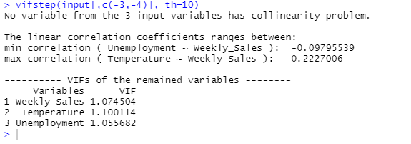
Variance Inflation Factor Analysis
This model is the best model because both independent variables have significant impact on weekly sales. The model has the lowest error and the vif at threshold 10. It reveals no multicollinearity amongst independent variables.

Slide 24
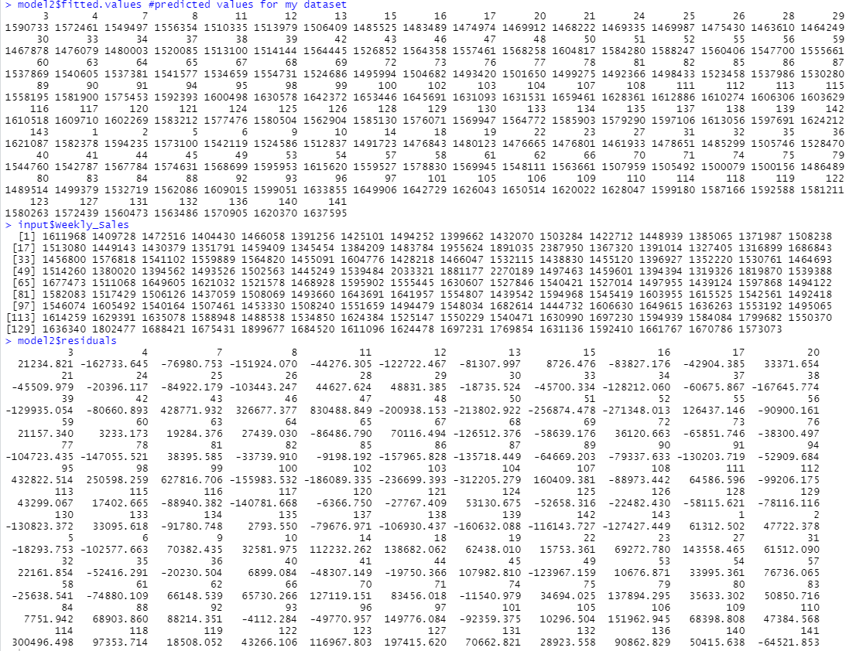
The predicted values and actual values can be compared with some level of error.
This execution shows the errors associated with this model.

Slide 25
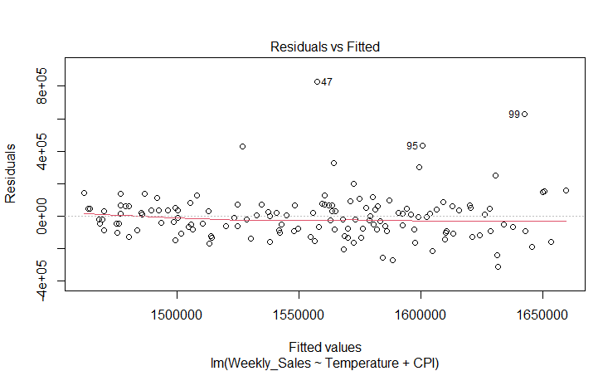
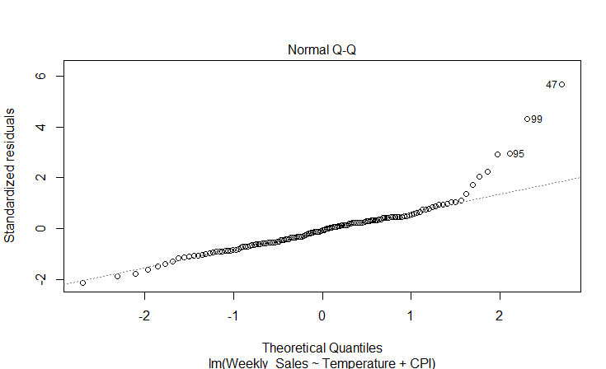
Data is homogeneously distributed indicating homoskedasticity. Relative to rest of the data points labeled 47, 95 & 99 are a little bit distant from the data.
There are a few outliers (47, 95 & 99) in the Normal Q-Q plot, but majority of the data falls on the line. We can say that the data is normally distributed.

Slide 26
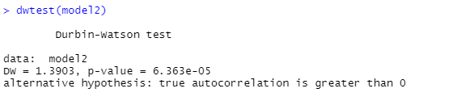
Dwtest is used to check for autocorrelation among residual errors.
H0:there is no correlation amongst residuals.
Null hypothesis statement for correlation amongst residual errors.
Null hypothesis cannot be rejected. The errors in this data has autocorrelation as the p value is less than 0.05.

Slide 27
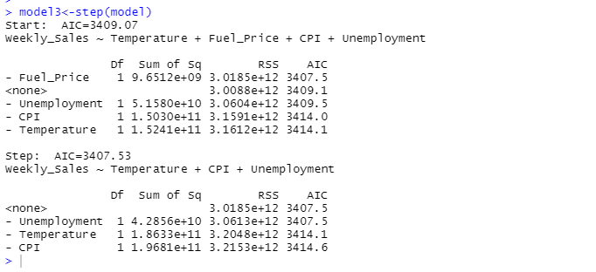
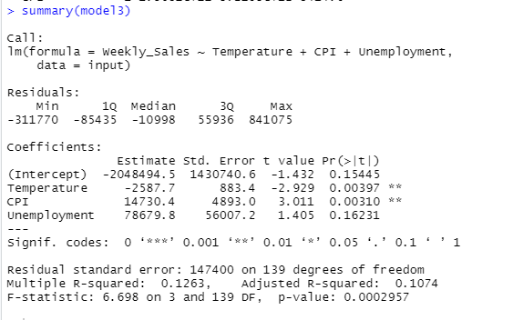
Step Method: Model 3
AIC was used to check for accuracy and complexity. The reduced model produced from this method involves Unemployment, Temperature and CPI. Note that the p value for unemployment is higher than 0.05 at 95% confidence level. Thus, unemployment was removed as an independent variable.
WeeklySales=-2048494.5 -2587.7temp+14730.4CPI+78679.8Unemp

Slide 28
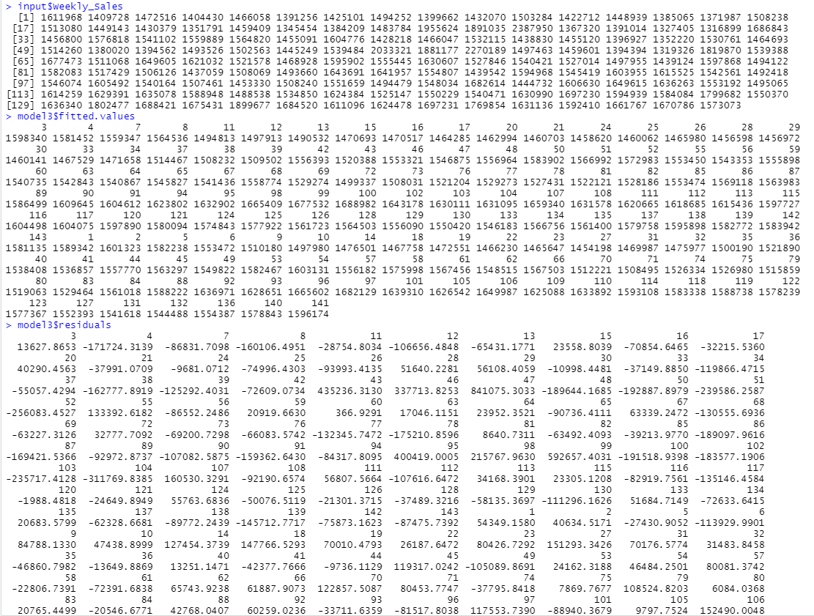
The predicted values and actual values can be compared with some level of error.
This execution shows the errors associated with this model.

Slide 29
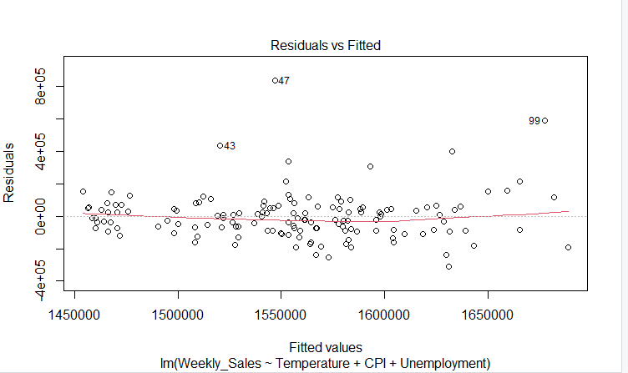
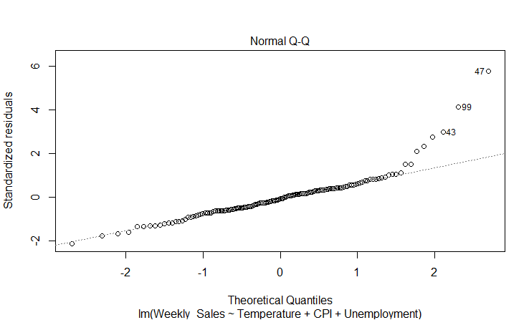
Data is homogeneously distributed indicating homoskedasticity. Relative to rest of the data points labeled 43, 47 , 99 are a little bit distant from the data.
There are a few outliers (43, 47, 99) in the Normal Q-Q plot, but majority of the data falls on the line. We can say that the data is normally distributed.

Slide 30
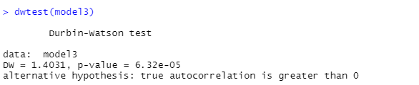
Dwtest is used to check for autocorrelation among residual errors.
H0:there is no correlation amongst residuals.
Null hypothesis statement for correlation amongst residual errors.
Null hypothesis cannot be rejected. The errors in this data has autocorrelation as the p value is less than 0.05.

Slide 31
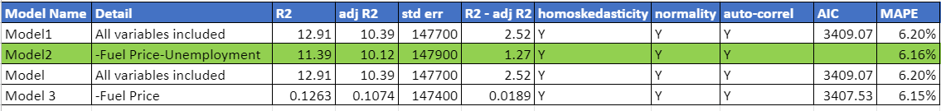
Comparison of Models
Model and Model 1 were the same using different methods.
Model using variance inflation factor was created with all independent variables as all vif values were less than the threshold of 10.
Model 1 with significance method revealed fuel price and unemployment p-values >0.05 at 95% confidence level, so those variable were removed.
Even though Model 3 has lowest difference of error (R2-adjR2), the unemployment’s p- value was greater than 0.05 at 95 % confidence level, hence it needed to be omitted from the model.
Model 2 then has the next lowest difference of errors and all independent variables were less than 0.05 at 95 % confidence level. The null hypothesis is rejected in this model. Temperature and CPI are indeed affecting weekly sales.
Model 2 proves to be the best model showing how weekly sales are affected. Temperature and CPI are the two independent variables that mostly affect weekly sales.

Slide 32
Summary of Statistical Methods and Approaches
The multiple linear regression involved four independent variables; temperature, fuel price, CPI and unemployment which reflect that each has some type of effect on weekly sales. In order to ensure that these independent variable were not correlating with each other, a variance inflation factor was done to check for multicollinearity. The Vif Method shows that none of the variables were strongly affecting each other. The first model was built using all independent variables
Secondly, Significance Method was used to find the best model by checking for p-values <0.05 at 95% confidence level. The best model indicates that temperature and CPI impact weekly sales the most.
Lastly the Step Method was performed. This method identified temperature, CPI and unemployment as the most impactful variables however the p values were checked for further analysis. Unemployment’s p value was greater than 0.05 at 05% confidence level. Unemployment was removed, leaving temperature and CPI as the two independent variables that highly affect weekly sales.
A few outliers were identified in the models, but the Normal Q-Q plot shows that majority of the errors are on the line. It is safe to say the plot indicates normal distribution. The display of residuals vs fitted plot shows homoskedasticity as the data points are homogeneously distributed.
The Error analysis performed were Derbin Watson test (dwtest) checking for autocorrelation among residual errors and MAPE which is the mean absolute percentage error. These were also used to identify the best model.
Including date in the model would not show significance to the model. However, the date is specific to Fridays and highest sales were produced by weeks of Thanksgiving 2010 and 2011.
Statistical Algorithm

Slide 33
Conclusion
The aim of this analysis was to build a model to forecast demands. In order to achieve the aim, data was analyzed using a statistical approach. Weekly sales of the 45 Walmart stores have been thoroughly analyzed, thus the following can be concluded:
Store 20 has the maximum weekly sales
Store 14 sales vary the most
In Quarter 3, Store 7 has the highest growth rate from Q2->Q3’2012 & Store 44 highest growth rate from the previous year 2011 to 2012 of the same quarter, Q3.
The holiday that dominates for highest weekly sales is Thanksgiving.
The best prediction model to forecast demand is
#weeklysales=-233190-2769temp1+9156cpi1

